Slide 1
Econ 135: Lecture 27:
7. Conclusion: Review and Future
Brad DeLong
Department of Economics & Blum Center, U.C. Berkeley; & WCEG
last revised: Su 2020-04-12
for presentation: Th 2020-06-06
Original course by Melissa Dell (Harvard Econ 1342), revised by Brad DeLong
<https://github.com/braddelong/public-files/blob/master/econ-135-lecture-27.pptx>
<https://www.icloud.com/keynote/0oLtY2dZ5V0_8A97uFNTi0oIg>

Slide 2
Discussion
The Past and the Future:
What strikes you as important here?

Slide 3
Review and Future Trends
27. Th May 7: 7. Review and Future:
Readings:
Robert Allen (2011): Global Economic History: A Very Short Indtroduction <https://delong.typepad.com/files/allen-geh.pdf>
Materials:
Readiness:
Slides: <https://github.com/braddelong/public-files/blob/master/econ-135-lecture-27.pptx>
Review:
Discussion:
Text:
Problem Set:

Slide 4
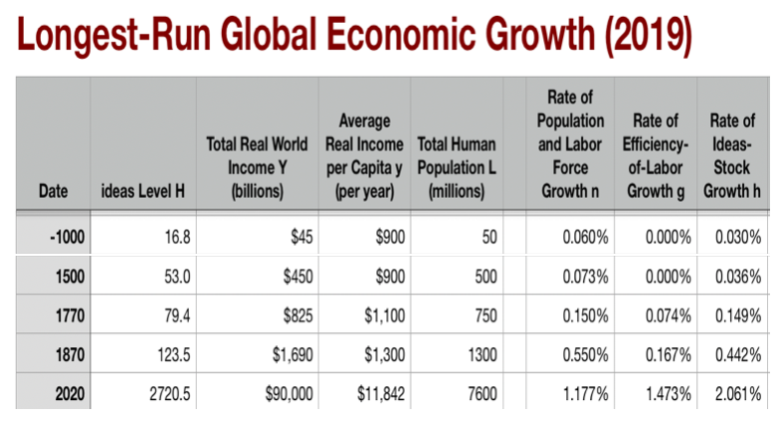

Background: Economic Growth
The eagle’s-eye view:
Three accelerations from agrarian-age norm: x 6.5, x 3.5, x 4.5
I got into this business in the 1980s: Paul Romer then argued a fourth acceleration was on the way
Did not happen (yet?)
03:15 of audio in this slide group; 2:00 here
Notes:
You will recall the eagle’s-eye view of global economic growth we took at the start. The long hunter-gatherer age. Fire, stone tools, language. Then the neolithic revolution, and the invention and discovery of herding and agriculture: cities, literacy, the state, large-scale human organization, command-and-control, and the-market-and-exchange.
This leaves us before the year -1000 with the Malthusian economy of the agrarian age. Typical living standards near (sociologically determined! that “sociologically” is important!) Malthusian subsistence. The rate of growth of the useful ideas stock averaging 0.03% per year—a doubling time of 2300 years. The rate of growth of population about twice that—a doubling time of 1150 years.
Then, dizzyingly, in 1500 the coming of the caravel, the conquest of the “West Indies” by Europeans, the knitting together of Eurasia into a single economic ekumene, the extraordinary intensification of slave raids on Africa, and the imperial age of the Commercial Revolution ratcheting up the pace of growth perhaps 6.5 fold; then in 1770 coal, steam, cotton, iron, and wool and the Industrial Revolution ratcheting up the pace of growth another 3.5-fold; then in 1870 modern economic growth with the industrial research lab, its STEM engineering-practice communities, the corporation, and globalization ratcheting up growth by another 4.5-fold so that now we see in 1 year more relative progress than the agrarian age saw in 50; now our level of useful ideas H stands at 2720 (while it stood at 125 in 1870, at 50 in 1500, at 17 in -1000, and at 1 70000 years ago).
Dizzying.
And back when I got into this business in the early 1980s, the very sharp Paul Romer was then arguing that a fourth acceleration was on the way. It did not happen. Or it did not happen yet.

Slide 5
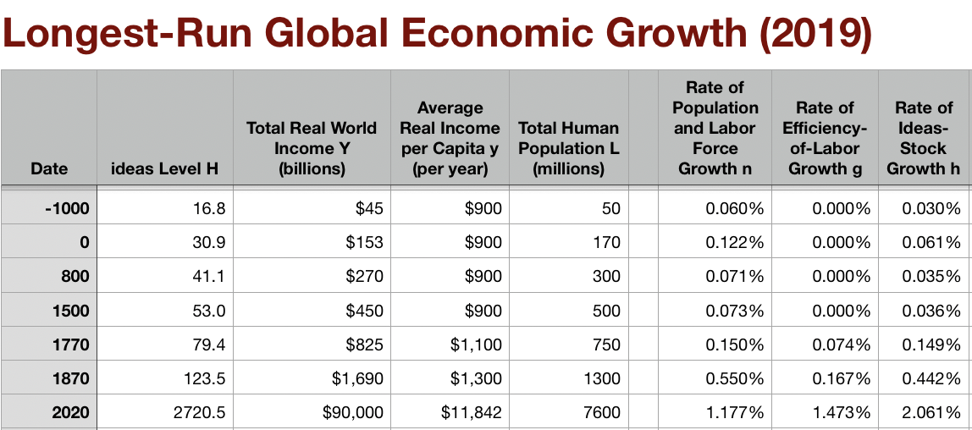
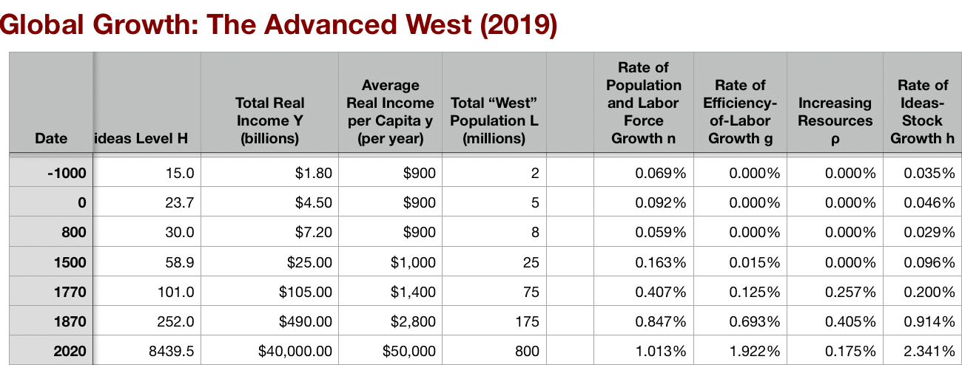
Features of Modern Economic Growth
As conventionally measured:
Ideas growth of 2.1%/yr:
Doubling time of 33 years
More change in one year than in 50 in the agrarian age
Enormous growth in global inequality
Driven by:
Industrial research lab: routinization & rationalization of invention & innovation
Modern corporation: routinization & rationalization of the deployment of ideas
Globalization
Transport
Communications
Migration
Demographic transition
American ascendancy: “the furnace where the future is being forged”
1:15
Notes:
This gives us the world of today, the world of modern economic growth, with its characteristic features.
Worldwide, as conventionally measured, ideas growth of 2.1%/yr: giving us a doubling time of 33 years, and, as I said, more change in one year than in 50 in the agrarian age. It has, as I said, been driven by: (a) the industrial research lab, (b) the resulting routinization & rationalization of invention & innovation in communities of engineering practice that they nurture, (c) the modern corporation with its routinization & rationalization of the deployment of ideas; plus (d) globalization in transport, communications, and—for a while, and to a degree—migration; all in the context of (e) the nearly completed demographic transition.
This long 20th century since 1870 has also seen American ascendancy: “the furnace where the future is being forged” in Leon Trotsky’s phrase. And it has seen enormous growth in global inequality, growth that I still find hard to explain or even to grasp.

Slide 6
Catch Our Breath…
Ask a couple of questions?
Make a couple of comments?
Any more readings to recommend?
<>

Slide 7
How Is Allen’s Picture Different from the One I Have Painted?
Starts in 1500: Mercantilism, Catch-Up, Big Push
Three accelerations from agrarian-age norm: x 6.5, x 3.5, x 4.5
I got into this business in the 1980s: Paul Romer then argued a fourth acceleration was on the way
Did not happen (yet?)
1870-present the story of the greatest growth surge and also the greatest divergence
??:?? of audio in this slide group; 2:00 here
Notes:
You will recall the eagle’s-eye view of global economic growth we took at the start. The long hunter-gatherer age. Fire, stone tools, language. Then the neolithic revolution, and the invention and discovery of herding and agriculture: cities, literacy, the state, large-scale human organization, command-and-control, and the-market-and-exchange.
This leaves us before the year -1000 with the Malthusian economy of the agrarian age. Typical living standards near (sociologically determined! that “sociologically” is important!) Malthusian subsistence. The rate of growth of the useful ideas stock averaging 0.03% per year—a doubling time of 2300 years. The rate of growth of population about twice that—a doubling time of 1150 years.
Then, dizzyingly, in 1500 the coming of the caravel, the conquest of the “West Indies” by Europeans, the knitting together of Eurasia into a single economic ekumene, the extraordinary intensification of slave raids on Africa, and the imperial age of the Commercial Revolution ratcheting up the pace of growth perhaps 6.5 fold; then in 1770 coal, steam, cotton, iron, and wool and the Industrial Revolution ratcheting up the pace of growth another 3.5-fold; then in 1870 modern economic growth with the industrial research lab, its STEM engineering-practice communities, the corporation, and globalization ratcheting up growth by another 4.5-fold so that now we see in 1 year more relative progress than the agrarian age saw in 50; now our level of useful ideas H stands at 2720 (while it stood at 125 in 1870, at 50 in 1500, at 17 in -1000, and at 1 70000 years ago).
Dizzying.
And back when I got into this business in the early 1980s, the very sharp Paul Romer was then arguing that a fourth acceleration was on the way. It did not happen. Or it did not happen yet.

Slide 8
Features of Modern Economic Growth
As conventionally measured:
Ideas growth of 2.1%/yr:
Doubling time of 33 years
More change in one year than in 50 in the agrarian age
Enormous growth in global inequality
Driven by:
Industrial research lab: routinization & rationalization of invention & innovation
Modern corporation: routinization & rationalization of the deployment of ideas
Globalization
Transport
Communications
Migration
Demographic transition
American ascendancy: “the furnace where the future is being forged”
1:15
Notes:
This gives us the world of today, the world of modern economic growth, with its characteristic features.
Worldwide, as conventionally measured, ideas growth of 2.1%/yr: giving us a doubling time of 33 years, and, as I said, more change in one year than in 50 in the agrarian age. It has, as I said, been driven by: (a) the industrial research lab, (b) the resulting routinization & rationalization of invention & innovation in communities of engineering practice that they nurture, (c) the modern corporation with its routinization & rationalization of the deployment of ideas; plus (d) globalization in transport, communications, and—for a while, and to a degree—migration; all in the context of (e) the nearly completed demographic transition.
This long 20th century since 1870 has also seen American ascendancy: “the furnace where the future is being forged” in Leon Trotsky’s phrase. And it has seen enormous growth in global inequality, growth that I still find hard to explain or even to grasp.

Slide 9
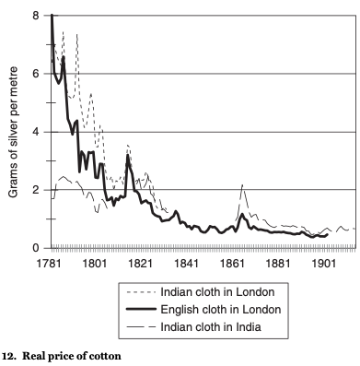
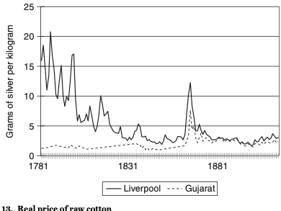
Allen’s Story: Underdevelopment of the Global South
Falling transportation costs led to greater economic integration:
Comparative advantage thus led industry to migrate to the global north…
Could only be resisted by the standard development strategy:
Internal improvements
Banks
Universal education
External tariffs
Colonies could not follow this strategy
Not all independents tried to grasp it
Not all that tried to grasp it succeeded
2:00
Notes:
Today I want to raise the question: might this dizzying picture be an underestimate of the growth acceleration?
Are these conventional measures at all accurate?
We have seen enormous changes in relative prices across the centuries. For example, a short printed book today trades for 2 lb. of flour—maybe not today, when flour sells out at the Orinda Safeway on those days they have it by 9:30 AM, but when we are not sheltering in place. But on the other hand, if you have a smartphone and if the book you want is on Project Gutenberg, then a short albeit not printed book has only connectivity, electricity, and battery and charger wear costs—say, 25 cents for consumables and depreciation of the smartphone while you are using it to read the book. That means a book trades for not 2 lbs of flour, but for 1/3 of an ounce of flour.
At a price of 25 denarii for 100 lines, a short book in the time of the Roman Emperor Diocletian in 300 traded for 250 lb. of flour. And it was the same in the time of Martial around 100: then it was 1 sestertius a page (note the 40-to-1 inflation)
The general labor wage then: 2.5 lbs. flour/day, or 0.01 books a day
The general labor wage now: 120 lbs. flour/day, or 60 books a day, or is it
6000?
I have 1000 physical books in my sight right now—that’s enough flour in the time of Diocletian or Martial to feed 3 cohorts of the imperial Roman army for a year. Plus there are all the books I have at my virtual fingertips…
Standard statistics say we are only 15 times as rich.
But on the wheat flour standard, a typical California annual household income today would pay the wages of 50 Roman men for a year.
On the physical book standard, a typical California annual household income today would pay the wages of Roman 1,500 men for a year.
And on the virtual book standard, a typical California annual household income today is 600,000 times as rich
Does 15 grossly underestimate it?

Slide 10
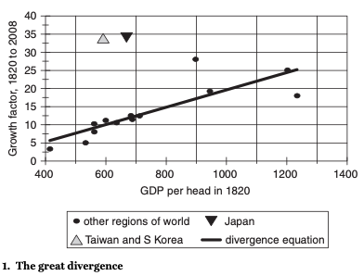
The Great Divergence since 1820
Countries x 3 richer in 1820 are x 15 richer today:
With East Asia being the only region that has significantly and strikingly broken the curve
And North America a secondary outlier
Britain falls behind
Hard to believe that this is some underlying factors showing through
Instead, being poor must have set in motion processes to make you poorer
What were they?
2:00
Notes:
Today I want to raise the question: might this dizzying picture be an underestimate of the growth acceleration?
Are these conventional measures at all accurate?
We have seen enormous changes in relative prices across the centuries. For example, a short printed book today trades for 2 lb. of flour—maybe not today, when flour sells out at the Orinda Safeway on those days they have it by 9:30 AM, but when we are not sheltering in place. But on the other hand, if you have a smartphone and if the book you want is on Project Gutenberg, then a short albeit not printed book has only connectivity, electricity, and battery and charger wear costs—say, 25 cents for consumables and depreciation of the smartphone while you are using it to read the book. That means a book trades for not 2 lbs of flour, but for 1/3 of an ounce of flour.
At a price of 25 denarii for 100 lines, a short book in the time of the Roman Emperor Diocletian in 300 traded for 250 lb. of flour. And it was the same in the time of Martial around 100: then it was 1 sestertius a page (note the 40-to-1 inflation)
The general labor wage then: 2.5 lbs. flour/day, or 0.01 books a day
The general labor wage now: 120 lbs. flour/day, or 60 books a day, or is it
6000?
I have 1000 physical books in my sight right now—that’s enough flour in the time of Diocletian or Martial to feed 3 cohorts of the imperial Roman army for a year. Plus there are all the books I have at my virtual fingertips…
Standard statistics say we are only 15 times as rich.
But on the wheat flour standard, a typical California annual household income today would pay the wages of 50 Roman men for a year.
On the physical book standard, a typical California annual household income today would pay the wages of Roman 1,500 men for a year.
And on the virtual book standard, a typical California annual household income today is 600,000 times as rich
Does 15 grossly underestimate it?

Slide 11
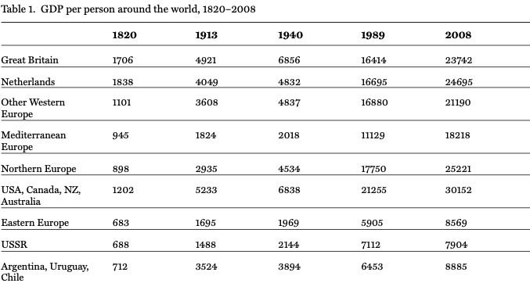
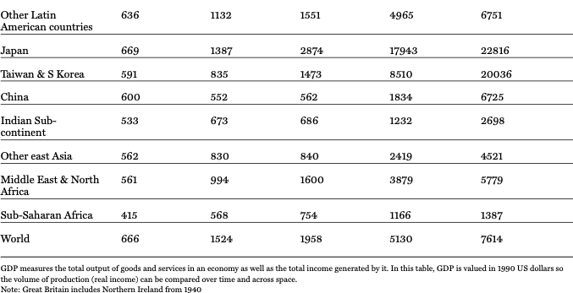
Allen’s Numbers
The degree of fit is remarkable:
As said before, the Pacific rim, North America, & Britain are the only significant outliers here…
Otherwise, differences scale up:
Threefold becomes fifteenfold
Twofold becomes four fold
2:00
Notes:
Today I want to raise the question: might this dizzying picture be an underestimate of the growth acceleration?
Are these conventional measures at all accurate?
We have seen enormous changes in relative prices across the centuries. For example, a short printed book today trades for 2 lb. of flour—maybe not today, when flour sells out at the Orinda Safeway on those days they have it by 9:30 AM, but when we are not sheltering in place. But on the other hand, if you have a smartphone and if the book you want is on Project Gutenberg, then a short albeit not printed book has only connectivity, electricity, and battery and charger wear costs—say, 25 cents for consumables and depreciation of the smartphone while you are using it to read the book. That means a book trades for not 2 lbs of flour, but for 1/3 of an ounce of flour.
At a price of 25 denarii for 100 lines, a short book in the time of the Roman Emperor Diocletian in 300 traded for 250 lb. of flour. And it was the same in the time of Martial around 100: then it was 1 sestertius a page (note the 40-to-1 inflation)
The general labor wage then: 2.5 lbs. flour/day, or 0.01 books a day
The general labor wage now: 120 lbs. flour/day, or 60 books a day, or is it
6000?
I have 1000 physical books in my sight right now—that’s enough flour in the time of Diocletian or Martial to feed 3 cohorts of the imperial Roman army for a year. Plus there are all the books I have at my virtual fingertips…
Standard statistics say we are only 15 times as rich.
But on the wheat flour standard, a typical California annual household income today would pay the wages of 50 Roman men for a year.
On the physical book standard, a typical California annual household income today would pay the wages of Roman 1,500 men for a year.
And on the virtual book standard, a typical California annual household income today is 600,000 times as rich
Does 15 grossly underestimate it?

Slide 12
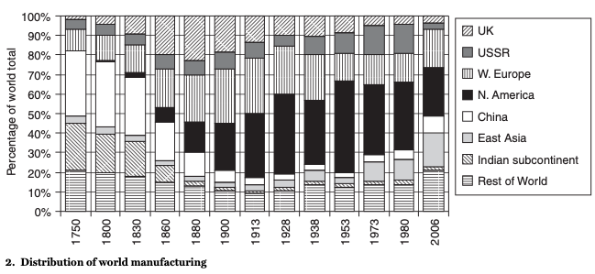
The Rise (and Fall) of British and Then American Manufacturing
Industrial technology’s flourishing:
Came first in one place: Britain
Then in a second place: America
The pre-1870 destruction of China’s and India’s relative manufacturing position
The post-1990 Chinese recovery
But India has not recovered
2:00
Notes:
Today I want to raise the question: might this dizzying picture be an underestimate of the growth acceleration?
Are these conventional measures at all accurate?
We have seen enormous changes in relative prices across the centuries. For example, a short printed book today trades for 2 lb. of flour—maybe not today, when flour sells out at the Orinda Safeway on those days they have it by 9:30 AM, but when we are not sheltering in place. But on the other hand, if you have a smartphone and if the book you want is on Project Gutenberg, then a short albeit not printed book has only connectivity, electricity, and battery and charger wear costs—say, 25 cents for consumables and depreciation of the smartphone while you are using it to read the book. That means a book trades for not 2 lbs of flour, but for 1/3 of an ounce of flour.
At a price of 25 denarii for 100 lines, a short book in the time of the Roman Emperor Diocletian in 300 traded for 250 lb. of flour. And it was the same in the time of Martial around 100: then it was 1 sestertius a page (note the 40-to-1 inflation)
The general labor wage then: 2.5 lbs. flour/day, or 0.01 books a day
The general labor wage now: 120 lbs. flour/day, or 60 books a day, or is it
6000?
I have 1000 physical books in my sight right now—that’s enough flour in the time of Diocletian or Martial to feed 3 cohorts of the imperial Roman army for a year. Plus there are all the books I have at my virtual fingertips…
Standard statistics say we are only 15 times as rich.
But on the wheat flour standard, a typical California annual household income today would pay the wages of 50 Roman men for a year.
On the physical book standard, a typical California annual household income today would pay the wages of Roman 1,500 men for a year.
And on the virtual book standard, a typical California annual household income today is 600,000 times as rich
Does 15 grossly underestimate it?

Slide 13
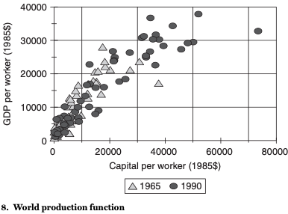
Does Allen Have an Explanation of Why the Poor Are Still Poor?
Not really:
He points to the capital-productivity correlation
But much of it is endogenous
It is much too strong to be causal
Should be 1-3, not 1-1…
2:00
Notes:
Today I want to raise the question: might this dizzying picture be an underestimate of the growth acceleration?
Are these conventional measures at all accurate?
We have seen enormous changes in relative prices across the centuries. For example, a short printed book today trades for 2 lb. of flour—maybe not today, when flour sells out at the Orinda Safeway on those days they have it by 9:30 AM, but when we are not sheltering in place. But on the other hand, if you have a smartphone and if the book you want is on Project Gutenberg, then a short albeit not printed book has only connectivity, electricity, and battery and charger wear costs—say, 25 cents for consumables and depreciation of the smartphone while you are using it to read the book. That means a book trades for not 2 lbs of flour, but for 1/3 of an ounce of flour.
At a price of 25 denarii for 100 lines, a short book in the time of the Roman Emperor Diocletian in 300 traded for 250 lb. of flour. And it was the same in the time of Martial around 100: then it was 1 sestertius a page (note the 40-to-1 inflation)
The general labor wage then: 2.5 lbs. flour/day, or 0.01 books a day
The general labor wage now: 120 lbs. flour/day, or 60 books a day, or is it
6000?
I have 1000 physical books in my sight right now—that’s enough flour in the time of Diocletian or Martial to feed 3 cohorts of the imperial Roman army for a year. Plus there are all the books I have at my virtual fingertips…
Standard statistics say we are only 15 times as rich.
But on the wheat flour standard, a typical California annual household income today would pay the wages of 50 Roman men for a year.
On the physical book standard, a typical California annual household income today would pay the wages of Roman 1,500 men for a year.
And on the virtual book standard, a typical California annual household income today is 600,000 times as rich
Does 15 grossly underestimate it?

Slide 14
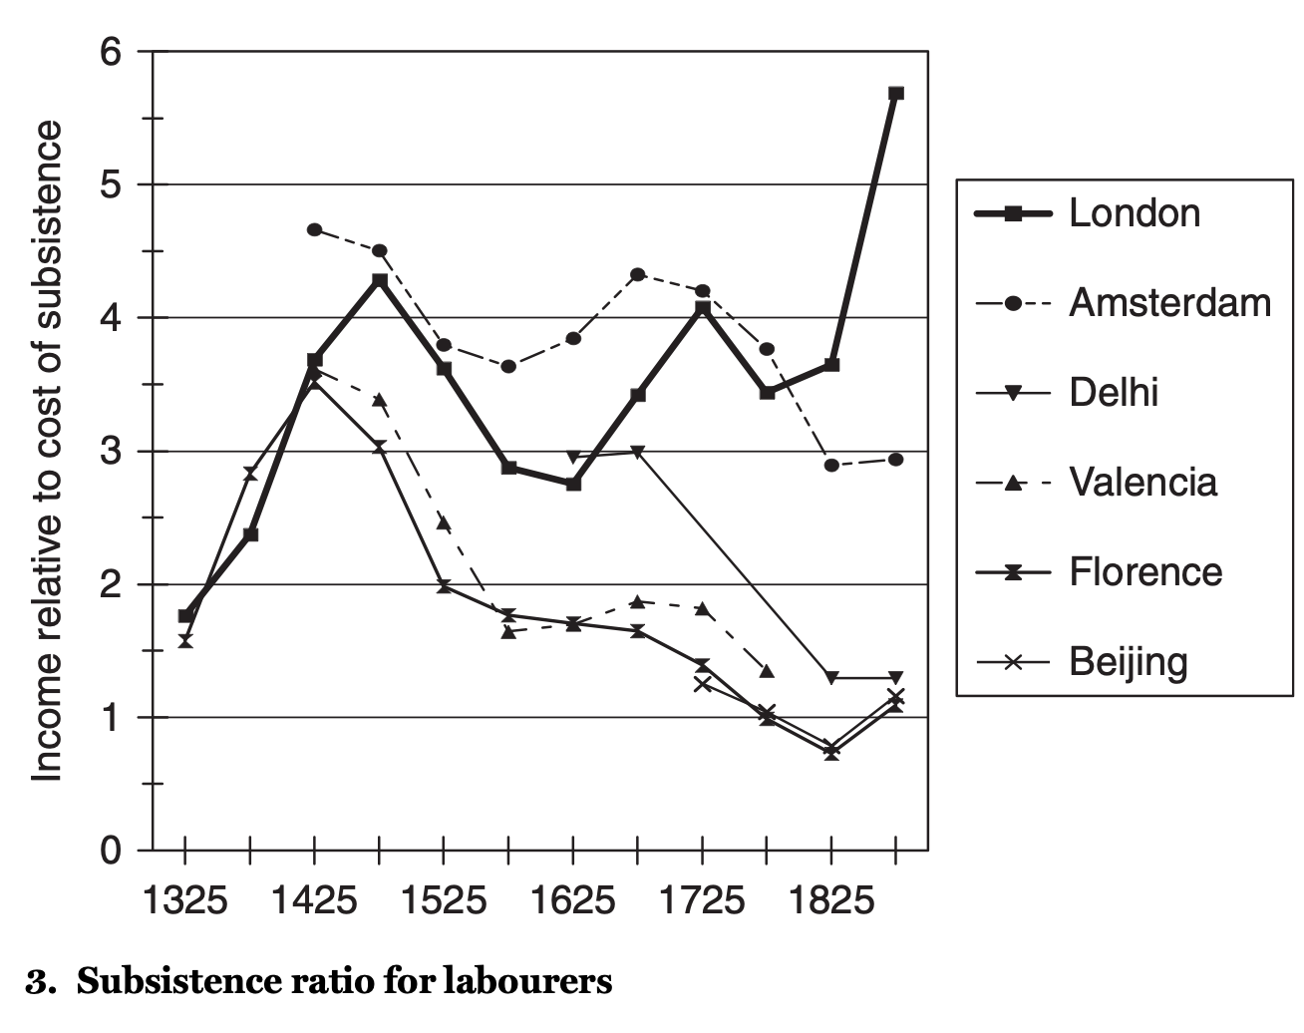
Northwest Europe Had a Substantial Edge from 1725
Not the European marriage pattern:
More easily traced to mercantile prosperity than to anything else
And it is that boost that then ramified substantially…
2:00
Notes:
Today I want to raise the question: might this dizzying picture be an underestimate of the growth acceleration?
Are these conventional measures at all accurate?
We have seen enormous changes in relative prices across the centuries. For example, a short printed book today trades for 2 lb. of flour—maybe not today, when flour sells out at the Orinda Safeway on those days they have it by 9:30 AM, but when we are not sheltering in place. But on the other hand, if you have a smartphone and if the book you want is on Project Gutenberg, then a short albeit not printed book has only connectivity, electricity, and battery and charger wear costs—say, 25 cents for consumables and depreciation of the smartphone while you are using it to read the book. That means a book trades for not 2 lbs of flour, but for 1/3 of an ounce of flour.
At a price of 25 denarii for 100 lines, a short book in the time of the Roman Emperor Diocletian in 300 traded for 250 lb. of flour. And it was the same in the time of Martial around 100: then it was 1 sestertius a page (note the 40-to-1 inflation)
The general labor wage then: 2.5 lbs. flour/day, or 0.01 books a day
The general labor wage now: 120 lbs. flour/day, or 60 books a day, or is it
6000?
I have 1000 physical books in my sight right now—that’s enough flour in the time of Diocletian or Martial to feed 3 cohorts of the imperial Roman army for a year. Plus there are all the books I have at my virtual fingertips…
Standard statistics say we are only 15 times as rich.
But on the wheat flour standard, a typical California annual household income today would pay the wages of 50 Roman men for a year.
On the physical book standard, a typical California annual household income today would pay the wages of Roman 1,500 men for a year.
And on the virtual book standard, a typical California annual household income today is 600,000 times as rich
Does 15 grossly underestimate it?

Slide 15
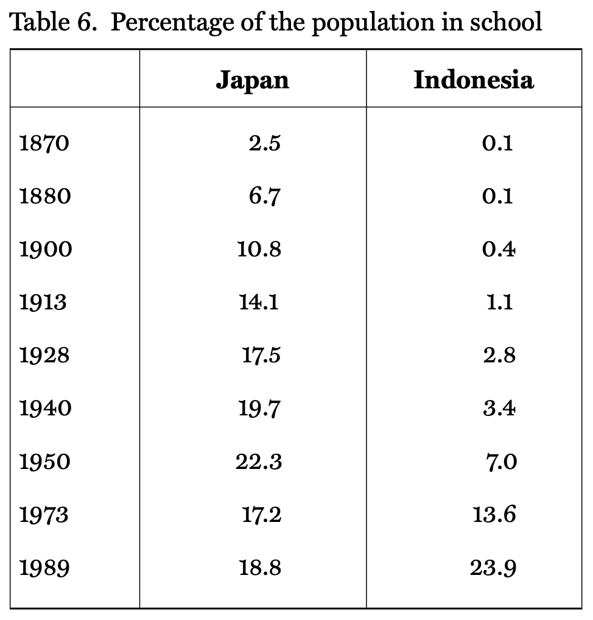
Human Capital as a Key Link
Putting a large chunk of your population in school by itself made up for a number of sins:
But colonies could not do so
And Islamic countries were late in doing so—especially as far as girls were concerned
Nevertheless, there is great cause for hope in what has gone on since 1960
2:00
Notes:
Today I want to raise the question: might this dizzying picture be an underestimate of the growth acceleration?
Are these conventional measures at all accurate?
We have seen enormous changes in relative prices across the centuries. For example, a short printed book today trades for 2 lb. of flour—maybe not today, when flour sells out at the Orinda Safeway on those days they have it by 9:30 AM, but when we are not sheltering in place. But on the other hand, if you have a smartphone and if the book you want is on Project Gutenberg, then a short albeit not printed book has only connectivity, electricity, and battery and charger wear costs—say, 25 cents for consumables and depreciation of the smartphone while you are using it to read the book. That means a book trades for not 2 lbs of flour, but for 1/3 of an ounce of flour.
At a price of 25 denarii for 100 lines, a short book in the time of the Roman Emperor Diocletian in 300 traded for 250 lb. of flour. And it was the same in the time of Martial around 100: then it was 1 sestertius a page (note the 40-to-1 inflation)
The general labor wage then: 2.5 lbs. flour/day, or 0.01 books a day
The general labor wage now: 120 lbs. flour/day, or 60 books a day, or is it
6000?
I have 1000 physical books in my sight right now—that’s enough flour in the time of Diocletian or Martial to feed 3 cohorts of the imperial Roman army for a year. Plus there are all the books I have at my virtual fingertips…
Standard statistics say we are only 15 times as rich.
But on the wheat flour standard, a typical California annual household income today would pay the wages of 50 Roman men for a year.
On the physical book standard, a typical California annual household income today would pay the wages of Roman 1,500 men for a year.
And on the virtual book standard, a typical California annual household income today is 600,000 times as rich
Does 15 grossly underestimate it?

Slide 16
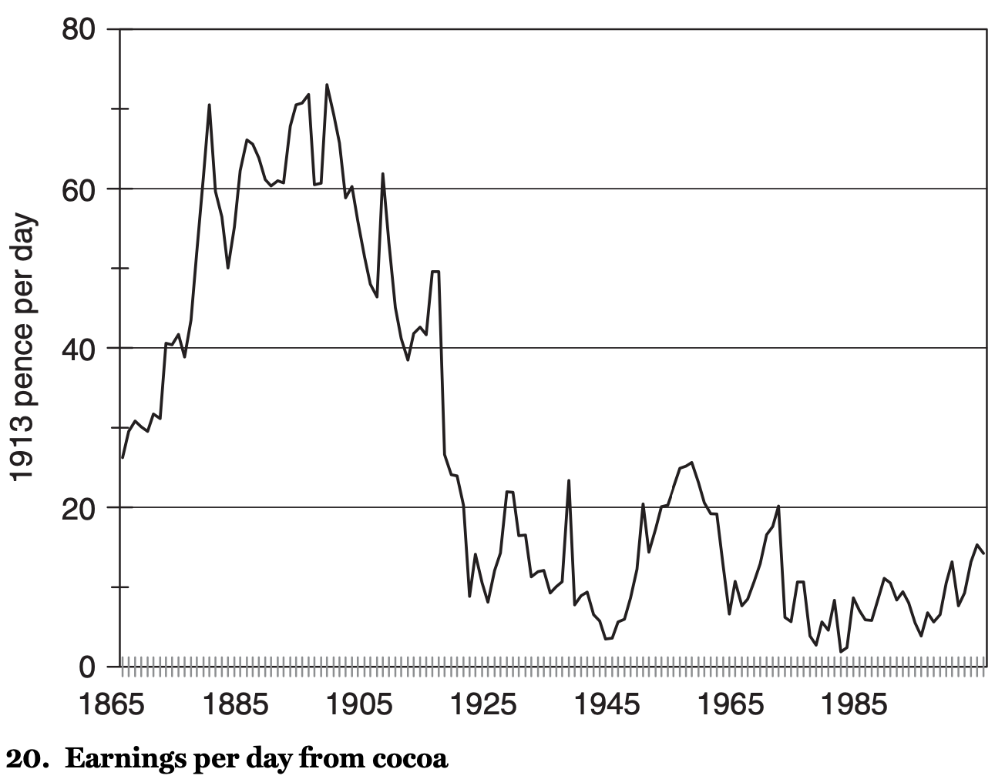
Getting Stuck in Primary Products
It’s not just that “tropical” products faced competition:
It is that it was not really possible to automate and mechanize very much
By contrast, manufacturing and materials handling were very mechanizable…
2:00
Notes:
Today I want to raise the question: might this dizzying picture be an underestimate of the growth acceleration?
Are these conventional measures at all accurate?
We have seen enormous changes in relative prices across the centuries. For example, a short printed book today trades for 2 lb. of flour—maybe not today, when flour sells out at the Orinda Safeway on those days they have it by 9:30 AM, but when we are not sheltering in place. But on the other hand, if you have a smartphone and if the book you want is on Project Gutenberg, then a short albeit not printed book has only connectivity, electricity, and battery and charger wear costs—say, 25 cents for consumables and depreciation of the smartphone while you are using it to read the book. That means a book trades for not 2 lbs of flour, but for 1/3 of an ounce of flour.
At a price of 25 denarii for 100 lines, a short book in the time of the Roman Emperor Diocletian in 300 traded for 250 lb. of flour. And it was the same in the time of Martial around 100: then it was 1 sestertius a page (note the 40-to-1 inflation)
The general labor wage then: 2.5 lbs. flour/day, or 0.01 books a day
The general labor wage now: 120 lbs. flour/day, or 60 books a day, or is it
6000?
I have 1000 physical books in my sight right now—that’s enough flour in the time of Diocletian or Martial to feed 3 cohorts of the imperial Roman army for a year. Plus there are all the books I have at my virtual fingertips…
Standard statistics say we are only 15 times as rich.
But on the wheat flour standard, a typical California annual household income today would pay the wages of 50 Roman men for a year.
On the physical book standard, a typical California annual household income today would pay the wages of Roman 1,500 men for a year.
And on the virtual book standard, a typical California annual household income today is 600,000 times as rich
Does 15 grossly underestimate it?

Slide 17
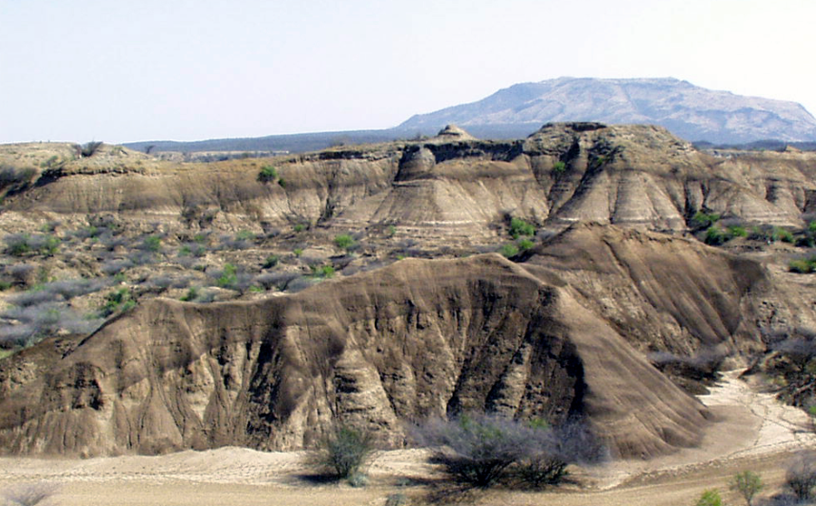

The Future?
We have come a long way:
Where are we likely to go next?

Slide 18
First: Back Up & Review
What Would the World Look Like Today?:
Without Commercial Revolution/Industrial Revolution/Modern Economic Growth?
What if 1500-today had been like 0-1500?

Slide 19
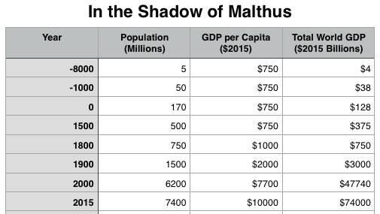
What Would the World Look Like Today without Commercial Revolution/Industrial Revolution/Modern Economic Growth?
1500-present like 0-1500…
Growing technological competence
Zeng He
Infante Dom Enrique and Bartolomeu Dias
But Malthusian dynamics
720 million people
GDP per capita of $750/yr
Technologies…
0-1500 TP about 0.03%/yr
Technologies of 1590 or so—“Elizabethan”; late Ming; early Mughal

Slide 20
Why Escape? Why Modern Economic Growth?
Useful ideas: five important prerequisites:
Resources
Science
Technology
A market economy
Profits to be made from productive innovation
Escape from Malthus
Nurturing its continuation—and noting its fragility—perhaps the most important goal, and the most important lesson
And here we get into astronomy and the Fermi paradox

Slide 21
The Future: Simple Extrapolation
Population maxes out at 9 billion…
GDP/L growth of 2%/year carries the world to…
$60K in ___ years
$240K in ___ years
$1M in ___ years
GDP/L growth of 0.5%/year carries the world to…

Slide 22
To Your iClickers…
From 2000 to 2015 the rate of growth in GDP per capita around the globe was about?
0.34% per year
1.7% per year
2.0% per year
0.20% per year
None of the above

Slide 23
To Your iClickers…
A rate of growth of 1.7% per year gives us a doubling time of about…
32 years
57 years
41 years
98 years
None of the above

Slide 24
To Your iClickers…
A rate of growth of 1.7% per year gives us a thousand-fold time of about…
4100 years
410 years
41 years
41000 years
None of the above

Slide 25
To Your iClickers…
At a rate of growth of 1.7% per year, world GDP per capita in 3000 would be about…
$187,100,000,000,000,000 per year
$187,100 per year
$37,420,000,000 per year
$187,100,000,000 per year
None of the above

Slide 26
How Fast Has GDP per Capita Worldwide Been since 1900?
1900: $2000 US per capita
2015: $10000 US per capita
1.4%/year
4.3%/year
$70/year
50 years
None of the above

Slide 27
If Per Capita GDP Growth Continues at Its 1.7%/year 2000-2015 Pace…
…when will the world average—which was $10000/year in 2015—attain the $60000/year that was the U.S. value in 2015?
About 2060
About 2120
About 2600
It cannot be calculated from the information given
None of the above

Slide 28
If Per Capita GDP Growth Continues at Its 1.7%/year 2000-2015 Pace…
…when will the world average—which was $10000/year in 2015—attain the $240000/year that was my household’s value in 2015?
About 2140
About 2200
About 3000
It cannot be calculated from the information given
None of the above

Slide 29
If Per Capita GDP Growth Continues at Its 1.7%/year 2000-2015 Pace…
…when will the world average—which was $10000/year in 2015—attain the value of $1000000/year
About 2220
About 2280
About 5000
It cannot be calculated from the information given
None of the above

Slide 30
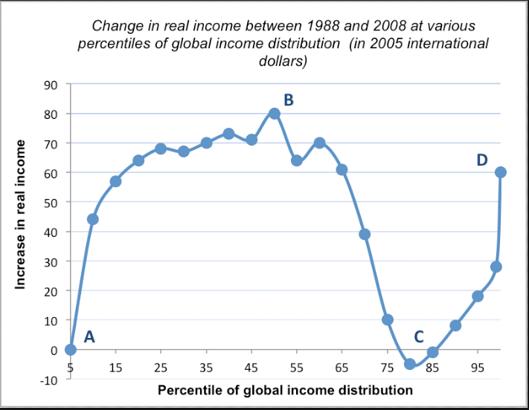
The Near Future
What happens next?
The Good: Finally, since 1970 some signs of global catch-up
The Bad:
Robert Gordon’s predictions of greatly slowed growth
Where are our flying cars?
Extrapolating growth is hazardous…

Slide 31
The Drake Equation
The number of civilizations in the galaxy is the product of
R*, the rate of star formation
fp, the fraction of stars with planets,
ne, habitable planets per star,
fl, fraction that develop life,
fi, fraction of living planets with intelligent, civilized life,
fc, fraction that communicate, and
L, how long civilizations last

Slide 32
The Great Filter?
Astronomy and the Fermi Paradox
The Drake Equation
We got R* ≈ 1 (or more)
fp, and ne ≈ 1
If fl, fi, and fc ≈ 10%
N = L x 10^(-3)
(N ≤ 1) ⇔ (L ≤ 10^3)
i.e., Earth will spend only 1000 years with civilized life…
The Great Filter
But see: Sandberg, Drexler, and Org <https://arxiv.org/pdf/1806.02404.pdf>

Slide 33
Big Ideas: Lecture 27: Review and Future
Takeaways from this lecture:

Slide 34
Catch Our Breath…
Ask a couple of questions?
Make a couple of comments?
Any more readings to recommend?

Slide 35
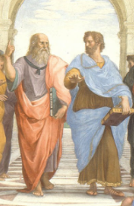
Notes, etc.…

Slide 36
Where We Think We Are with Coronavirus
Brad DeLong
2020-05-06
<https://www.icloud.com/keynote/0YKEi7HeOrVGvKYtt9FEqH7nA>
<https://github.com/braddelong/public-files/blob/master/coronavirus.pptx>

Slide 37
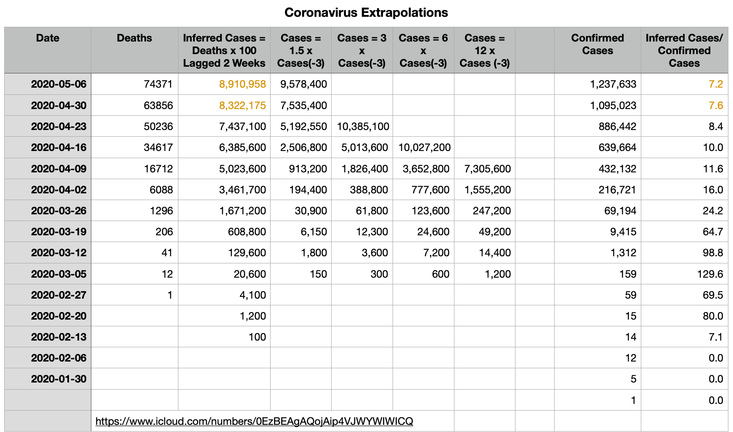
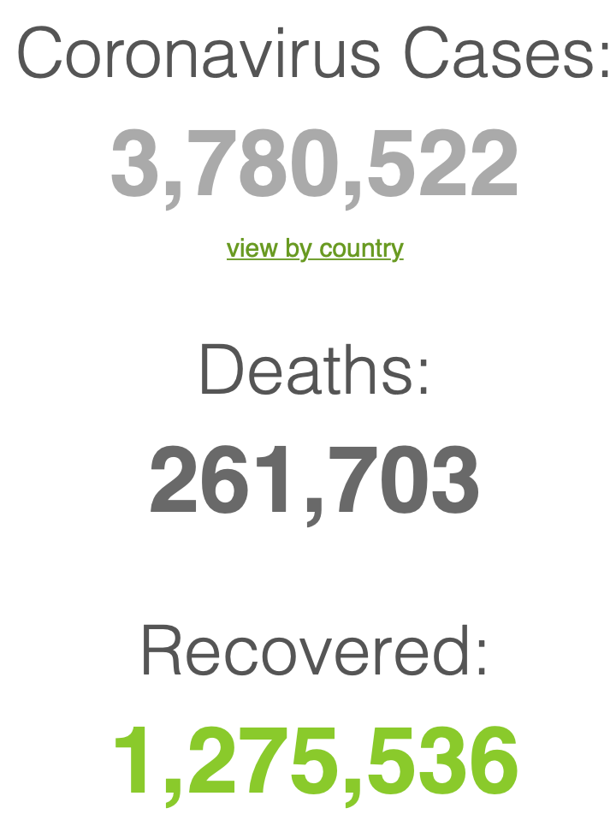
Simple Extrapolations and Inferences
Where we think we are, as of We May 6, 2020:
We still do not know: no random panel
I have my extrapolations: perhaps 9M cases?
Time to distinguish between Greater New York and the rest of the country?
audio time

Slide 39
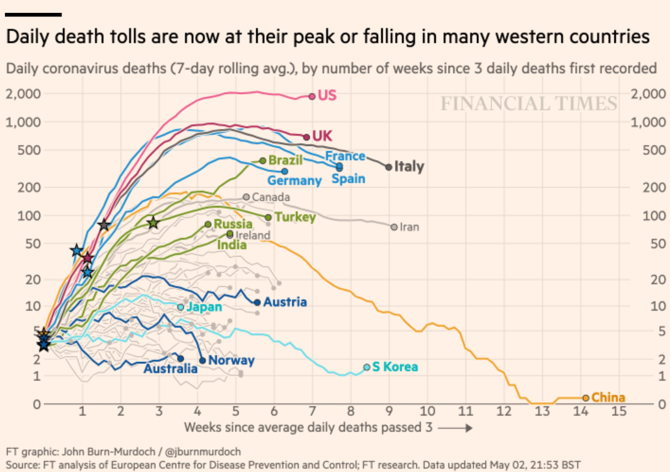
The United States Is Alone in Doing No More than Flattening the Death Line
And that is including New York:
And odds are that the U.S. daily death curve is about to start heading northeast again
How far and how fast will it move?
Cases x 150 during March
Cases x 3 during April
Am I wrong to expect a doubling outside New York in May?
audio time

Slide 40
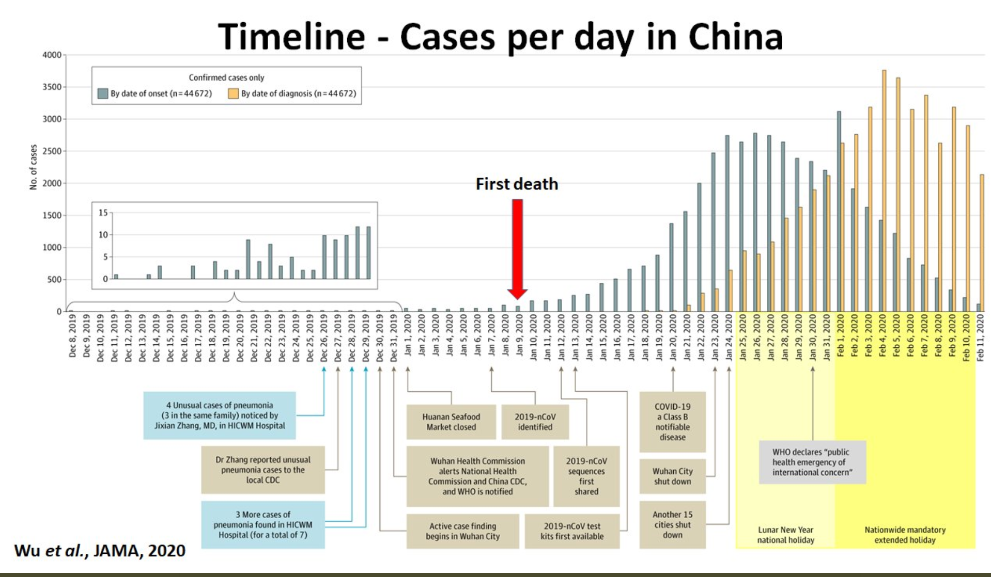
What We Think Happened in Wuhan
Wuhan beat it quickly—we think
Shut down Wuhan when there were 200 cases per day
Seems to have been a good choice
audio time

Slide 41
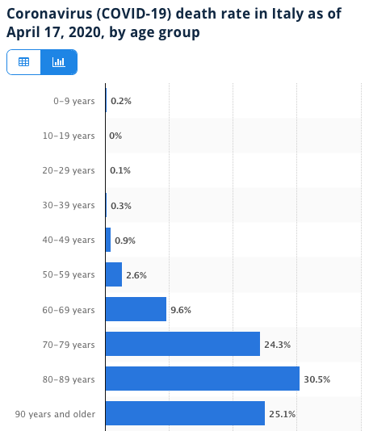
Death for Geezers!
Mortality for the Youngs low…
It can be a (very bad) flu for them—for you students…
Morbidity…
For olders: 3% in your 50s, 9% in your 60s
And a doubling—or is it 5%?—mortality for the asthmatic
And a doubling—or is it 5%?—mortality for the overweight
And an extra ???? if you have high blood pressure
And an extra ???? if you have high blood sugar
audio time

Slide 42
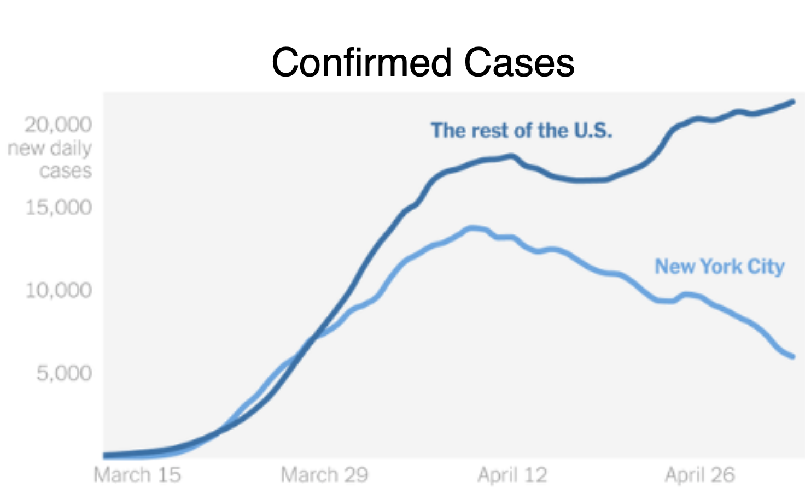
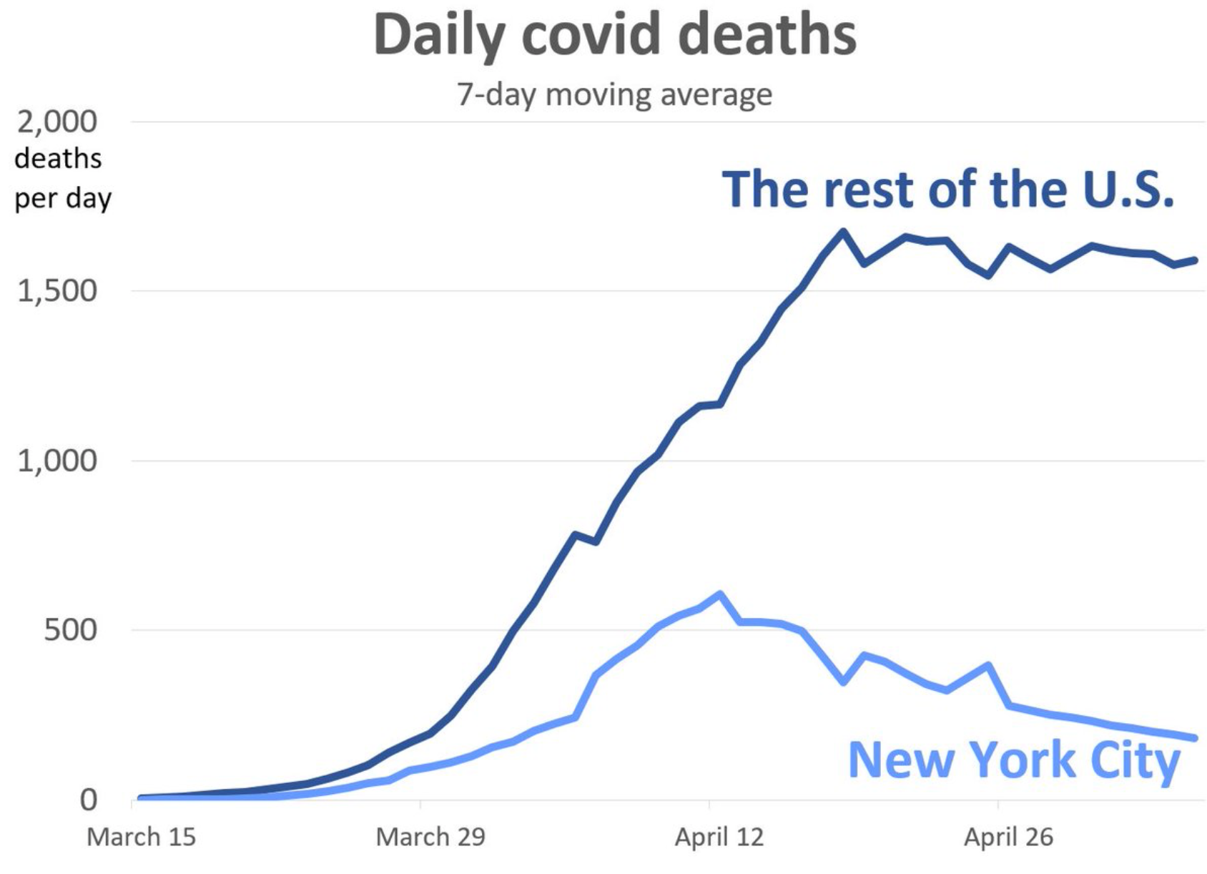
Separating New York City
New York City is well past its first epidemic peak:
The rest of the country is not
Perhaps 20% of the population of New York City has been brushed by the virus
Perhaps 2.5% of the country has been brushed by the virus
“Reopening” elsewhere will produce a lot of bad stuff
audio time

Slide 43
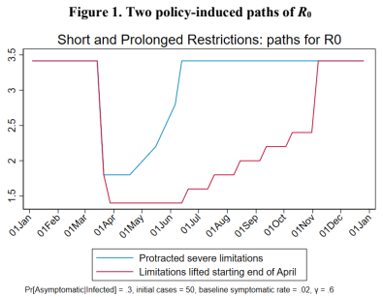
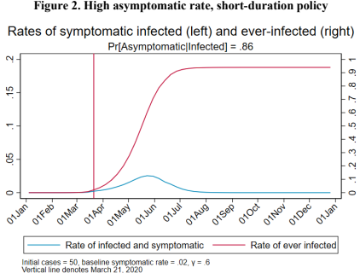
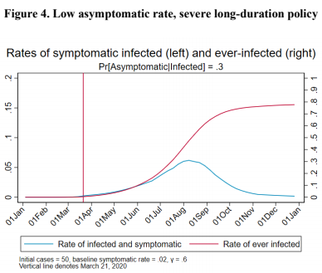
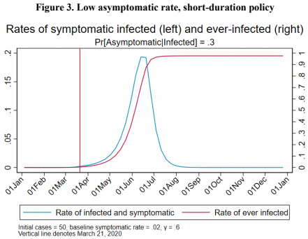
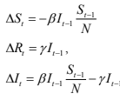
Integrating Public Health with Economics
Best thing I have read, still:
Comes from Jim Stock <https://www.jimstock.org>
Jim Stock: Coronavirus Data Gaps and the Policy Response <https://drive.google.com/file/d/12MV466ZZy5xHir4xdPhoTrL1oO8CbZU-/view>:
The basic SIR epidemiological model of contagion
What policy should be hinges on the coronavirus non-testing rate
Estimates in the epidemiological literature range from 0.18 to 0.86.
That is a case-catching rate of no less than 1/7—half of what extrapolations from 1% suggest
Does that mean we are dealing with a 2% virus?
audio time

Slide 44
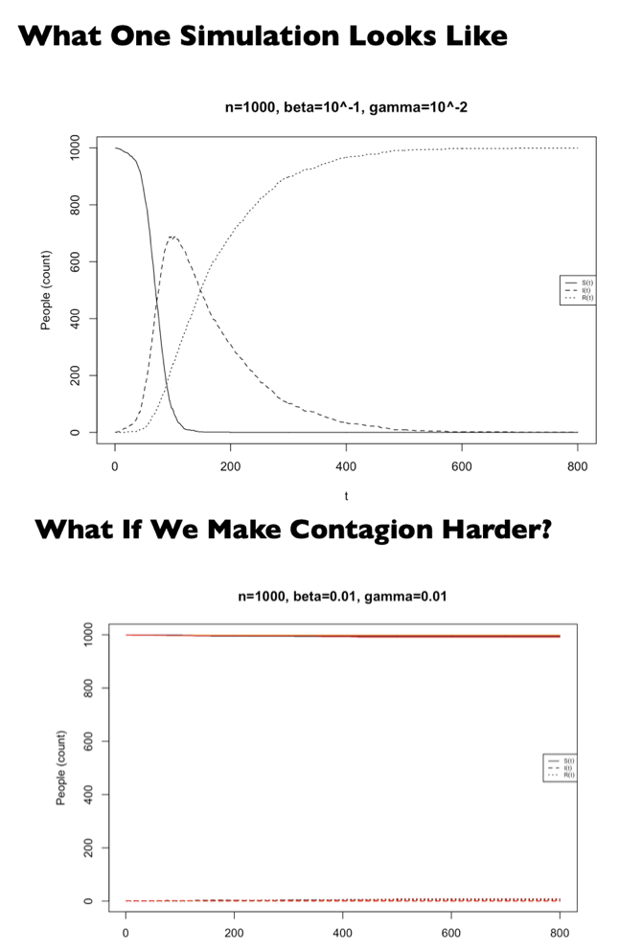
Second Best: Epidemic Models
A requested special topic:
Written and presented by Cosma Shalizi
Of Carnegie-Mellon University
<http://www.stat.cmu.edu/~cshalizi/dm/20/lectures/special/epidemics.html#(1)>
36-462/662, Spring 2020
16 April 2020 (Lecture 25)
audio time :: From Cosma Shalizi of Carnegie-Mellon: <http://www.stat.cmu.edu/~cshalizi/dm/20/lectures/special/epidemics.html#(1)>

Slide 45
Bringing the Economy Back Up from Anæsthesia
Major issues:
Certificates of immunity:
Which requires test, test, test:
And not just disease virus tests
Presence-of-antibodies tests
How quickly can we match the immune with public-contact jobs?
What jobs can be done with minimal infection risk?
What minimal-infection substitutes can we find for previous jobs?
How quickly can restrictions be relaxed without the virus coming roaring back?
How do we avoid having the market give a “shutdown” signal to enterprises we in fact want restarted?
Which is pretty much all of them
How much of the potential caseload do we want to push out beyond the vaccine-arrival date?
ALL THESE QUESTIONS ARE ANSWERABLE IF WE LEARN THE ASYMPTOMATIC HENCE NON-TESTED RATE!!
audio time

Slide 46
Keeping the Economy from Crashing During the Lockdown
Nick Rowe: We have a 50% output cut in 100% of the sectors:
A temporary 100% output cut in 50% of the sectors (what the Coronavirus does) is very different from a 50% output cut in 100% of the sectors
Nick’s thought experiment:
In three months we are going to invent unobtanium:
Substantial intertemporal substitutibility
Plus lower cross-good contemporaneous substitutitbility
Hence high desired savings rate now
Flex-price market thus produces a nominal rate at the zero lower bound and a high inflation rate over the next three to six months
Plus liquidity-constrained workers in affected sectors see their demand go to zero immediately
Can we get there? Should we get there? What should we do instead?
We need a good RBC economist: are there any?…
<https://worthwhile.typepad.com/worthwhile_canadian_initi/2020/03/relative-supply-shocks-unobtainium-walras-law-and-the-coronavirus.html>
audio time

Slide 47
Keeping the Economy from Crashing During the Lockdown II
Nick Rowe:
<https://worthwhile.typepad.com/worthwhile_canadian_initi/2020/03/relative-supply-shocks-unobtainium-walras-law-and-the-coronavirus.html>
Plus: to extend the thought experiment:
We just lost the ability to make “unobtainium”
So we should be substituting leisure for work, and moving workers into relatively unproductive labor, making the commodities we can still produce right now
How should relative prices move as a result? How should we make them move?
Plus: distributional issues
Plus: bankruptcy and credit chain issues
audio time

Slide 48
References
Directly cited here:
Financial Times (2020): Coronavirus Tracked: The Latest Figures as the Pandemic Spreads <https://www.ft.com/coronavirus-latest>
Nick Rowe (2020): Relative Supply Shocks, Unobtainium, Walras' Law, and the Coronavirus <https://worthwhile.typepad.com/worthwhile_canadian_initi/2020/03/relative-supply-shocks-unobtainium-walras-law-and-the-coronavirus.html>
Jim Stock (2020): Coronavirus Data Gaps and the Policy Response <https://drive.google.com/file/d/12MV466ZZy5xHir4xdPhoTrL1oO8CbZU-/view>
What I am watching:
Jim Stock (2020): Coronavirus Data Gaps and the Policy Response <https://drive.google.com/file/d/12MV466ZZy5xHir4xdPhoTrL1oO8CbZU-/view>
Max Roser & Hannah Ritchie: Coronavirus Disease (COVID-19) <https://ourworldindata.org/coronavirus>…
Worldometer: Coronavirus Update (Live) <https://www.worldometers.info/coronavirus/>…
FT Coronavirus Tracker <https://www.ft.com/content/a26fbf7e-48f8-11ea-aeb3-955839e06441>
Josh Marshall’s COVID Twitter List <https://twitter.com/i/lists/1233998285779632128>
NEJM Group: Updates on the Covid-19 Pandemic <http://m.n.nejm.org/nl/jsp/m.jsp?c=%40kxNtXckRDOq8oG0jJvAXsIzN4mPECIPhltxoTSdTU9k%3D&cid=DM89089_NEJM_COVID-19_Newsletter&bid=173498255>: 'From the New England Journal of Medicine, NEJM Journal Watch, NEJM Catalyst, and other trusted sources...
audio time

Slide 49
Catch Our Breath…
Continue the Discussion:
Ask a couple of questions?
Make a couple of comments?
Any more readings to recommend?
Files:
<https://www.icloud.com/keynote/0YKEi7HeOrVGvKYtt9FEqH7nA>
<https://www.bradford-delong.com/2020/04/coronavirus.html>
github:<https://github.com/braddelong/public-files/blob/master/coronavirus.pptx>
https://github.com/braddelong/public-files/blob/master/coronavirus.pdf>
html file: <https://www.bradford-delong.com/2020/04/coronavirus.html>
html edit: <https://www.typepad.com/site/blogs/6a00e551f08003883400e551f080068834/post/6a00e551f080038834025d9b3bd66a200c/edit>
<https://delong.typepad.com/files/2020-04-01-coronavirus.pdf>
audio time

Slide 50
Notes

Slide 51
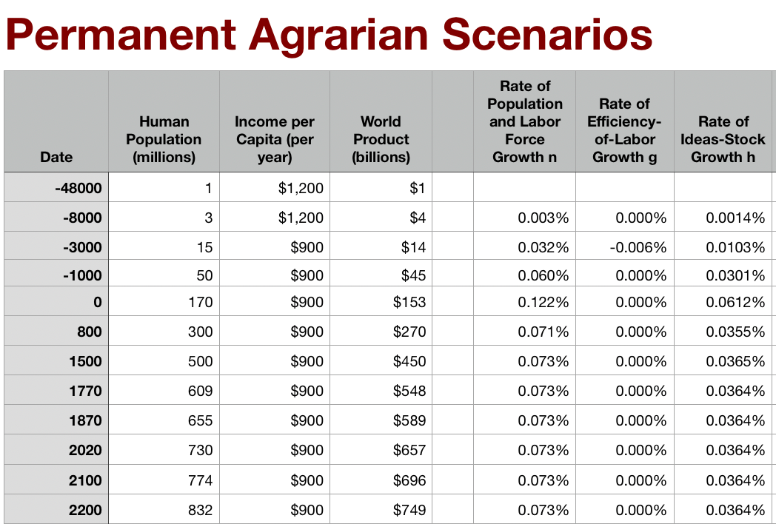
Permanent Agrarian Age World
What if there had been no Commercial Revolution?
What would we have to eliminate from our world?
The New World & the Columbian Exchange
Merchant republics & constitutional monarchies
Printing as transformative for intellectual life?
Is this plausible?
Rate of ideas growth settles at 0.035%/yr = 0.7%/generation
Doubling time of 2000 years
World today of 1/10 population, $2.50/day
Population growing at glacial pace

Slide 52
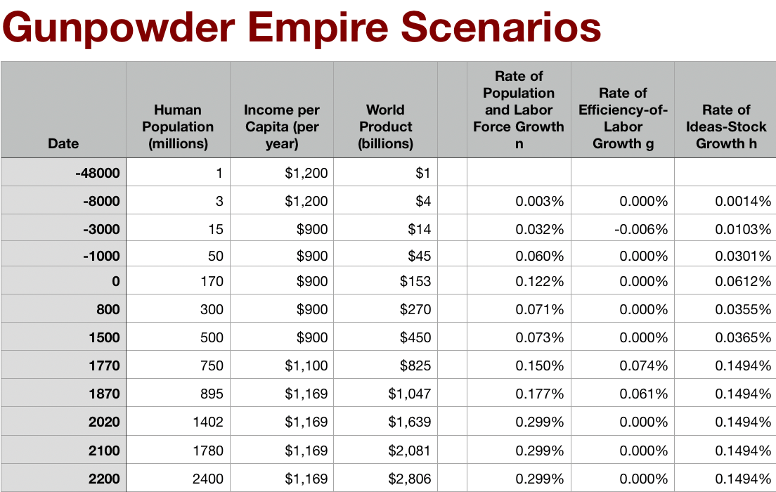
Gunpowder Empire World
What if things had stuck at the Commercial Revolution?
What would we have to eliminate from our world?
Coal or the British Empire
Science, tinkering, and nature manipulation?
Is this plausible?
Global rate of ideas growth of 0.15%/yr = 4%/generation, broadly shared
Doubling time of 500 years
World today of 1/5 our population, $3/day

Slide 53
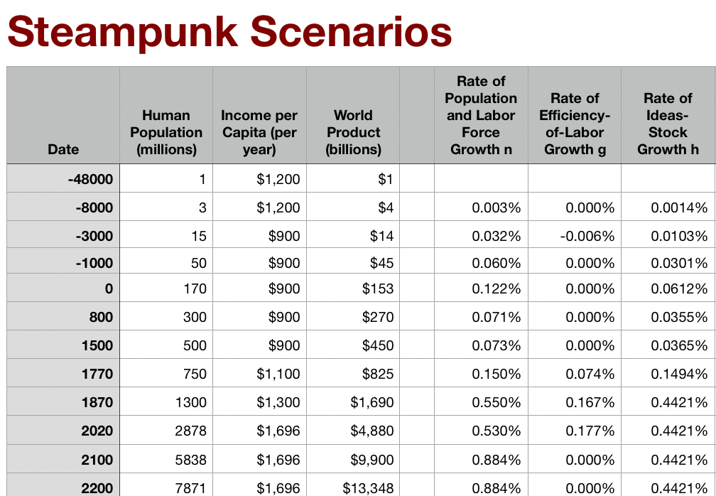
Steampunk World
What if there had been no Industrial Revolution?
What would we have to eliminate from our world?
Post-1870 speedup of STEM labor force growth
Industrial research lab to rationalize & routinize & modern corporation to deploy ideas
Globalization?
Is this plausible?
Stepping-on-toes & low-hanging-fruit
Arguments that it was inevitable lead to expectations of further growth accelerations—which we have not had
World settles at ideas growth of 0.44%/yr—12%/generation
doubling time of 150 years
World today of 2.7 billion, $5/day
World reaches today’s population in 2200

